Slide 1

Covid-19 vaccine analysis
Exploratory data analysis
Statistical analysis
visualization

Slide 2
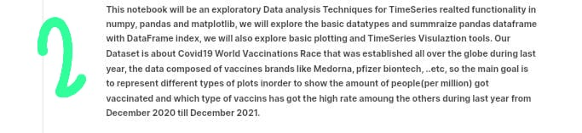
Exploratory data analysis

Slide 3
Dataset link : https://www.kaggle.com/datasets/gpreda/covid-world-vaccination-progress
COVID-19 pandemic is an ongoing pandemic that caused by severe acute respiratory virus. The virus was first identified from an outbreak in China in December 2019 and beginning to spread to other areas. The World Health Organization declared the international emergency health and called that event as pandemic. This COVID-19 pandemic has caused a health and economic crisis for many countries especially Southeast Asian countries. Goverments in Southeast Asian countries have policies to respond the risk of pandemic like vaccine program .
In this project, we will track vaccine usage progress in Southeast Asian nations to see how they reduce pandemic risk.
Prepare and Process
Because the purpose of this project is to practice my SQL skill, the tools that we will used to do this project is mostly SQL with help of Google Big Query. SQL statements are used to retrieve and update data in a database.
I will do the query in Big Query console and put some screenshots of the query syntax and its output here with markdown format to make it easier.

Slide 4
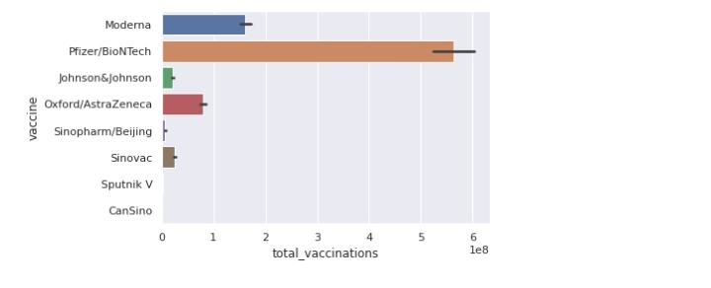
Data Integrity and Privacy Data is collected daily from Our World in Data GitHub repository. Country level vaccination data is gathered and assembled in one single file. A second file, with manufacturers information, is included. This data also contain the source name and its web of each data input.
We see that the data is not normalise yet, but we will try to figure it out with only SQL.
Sort and Filter I am curious about how Southeast Asian countries vaccine progress. So in the next step we will only use data from SEA countries by filtering the location and country data.

Slide 5
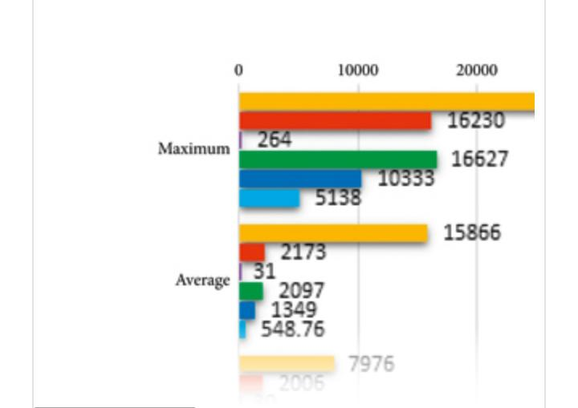
Statistical analysis
Measures of central tendency and dispersion of the components of COVID-19 in Bangladesh are included in this section. We consider the maximum daily cases, their average, quarterly positions as the measures of central tendency. On the other hand, mean deviation, standard deviation, and their coefficients (in percentage) are taken as the measures of dispersion. Figure 1 demonstrates the abovementioned statistical measures of components of COVID-19 in Bangladesh.

Slide 6
The maximums of the COVID-19 components are far ahead of their average values. In comparison to the average values, the mean deviation and standard deviation are found very high. For almost every component, the mean deviation is about of the average, whereas it is about for the Standard deviation. Those measures of dispersion are close to only for the number of tests. The measures of the quartiles display the none quidistant positioning that indicates a nonuniform distribution of the target data. So, from the graphical testimony, it can be claimed that the COVID-19-related data are moderately scattered and have noticeable irregularity . Since the magnitudes of the data of COVID-19 components are unequal, a collective comparison is not possible in their current values. As the remedy of this problem, the scores of the desired components are estimated and exhibited them through a Box-Whisker plot

Slide 7
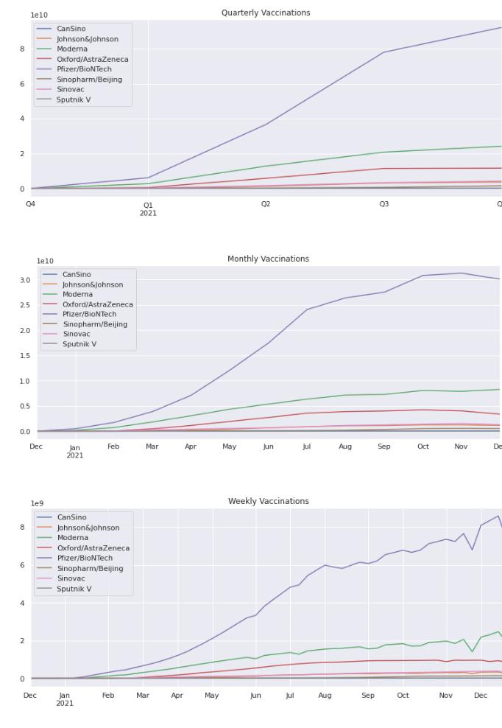
visualization

Slide 8
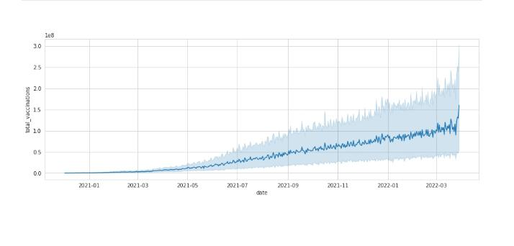
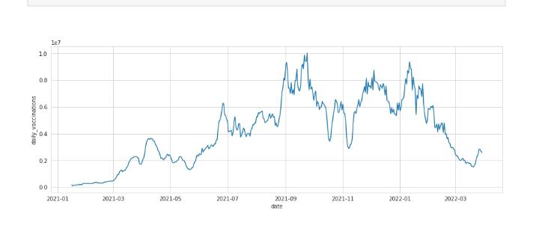
Total vaccination in India
Daily vaccination in India

Slide 9
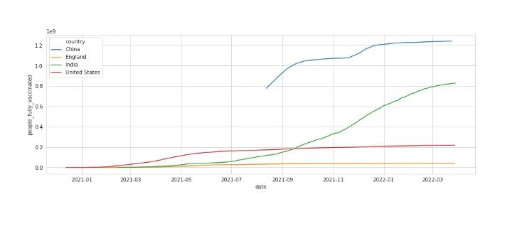
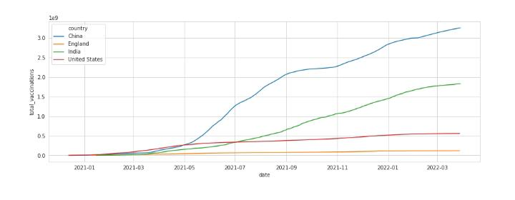
Daily vaccination comparison
Total vaccination comparison

Slide 10
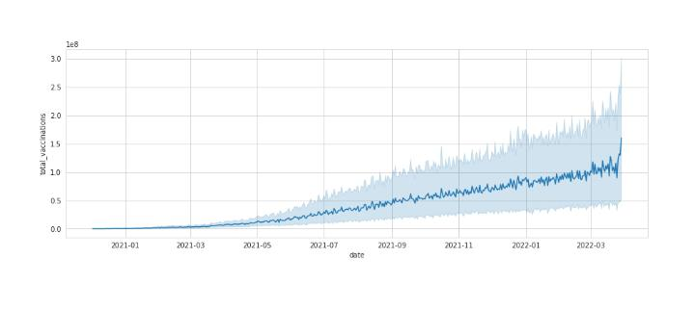
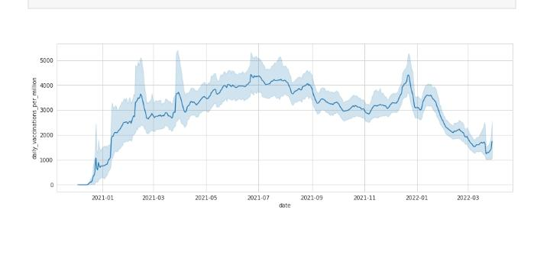
Daily vaccination per million
Total vaccination per million

Slide 11
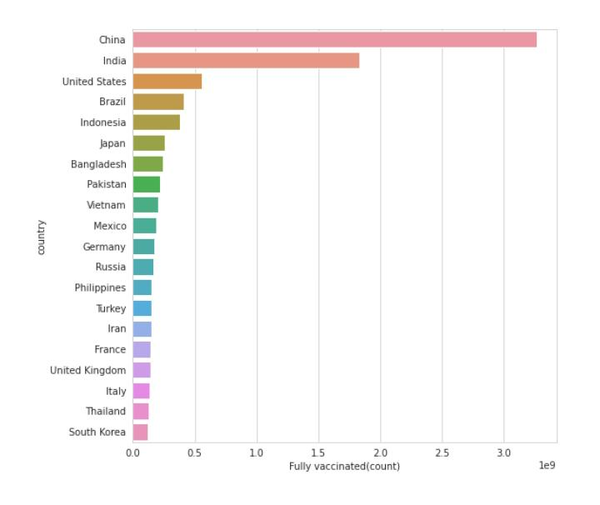
Top most countries with full vaccination

